Slide 1
PPHA 31202: Week 5

Slide 2
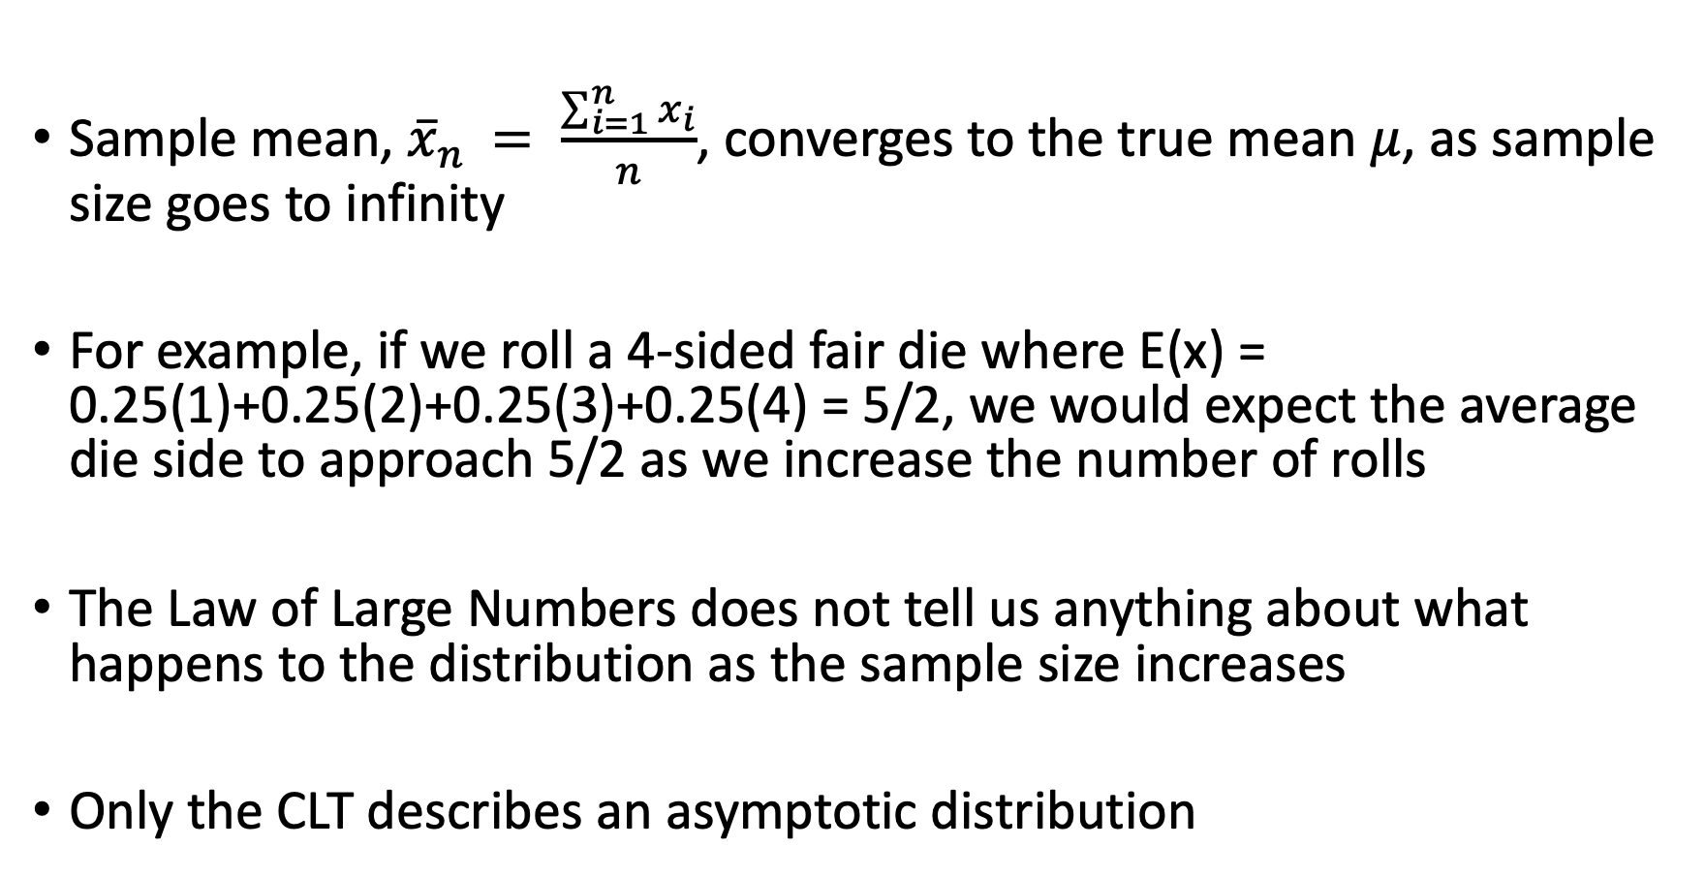
Law of Large Numbers
Sample mean, ${\overline{x}}_{n }= \frac{\sum_{i=1}^{n}{x_{i}}}{n}$, converges to the true mean $μ$, as sample size goes to infinity
For example, if we roll a 4-sided fair die where E(x) = 0.25(1)+0.25(2)+0.25(3)+0.25(4) = 5/2, we would expect the average die side to approach 5/2 as we increase the number of rolls
The Law of Large Numbers does not tell us anything about what happens to the distribution as the sample size increases
Only the CLT describes an asymptotic distribution

Slide 3
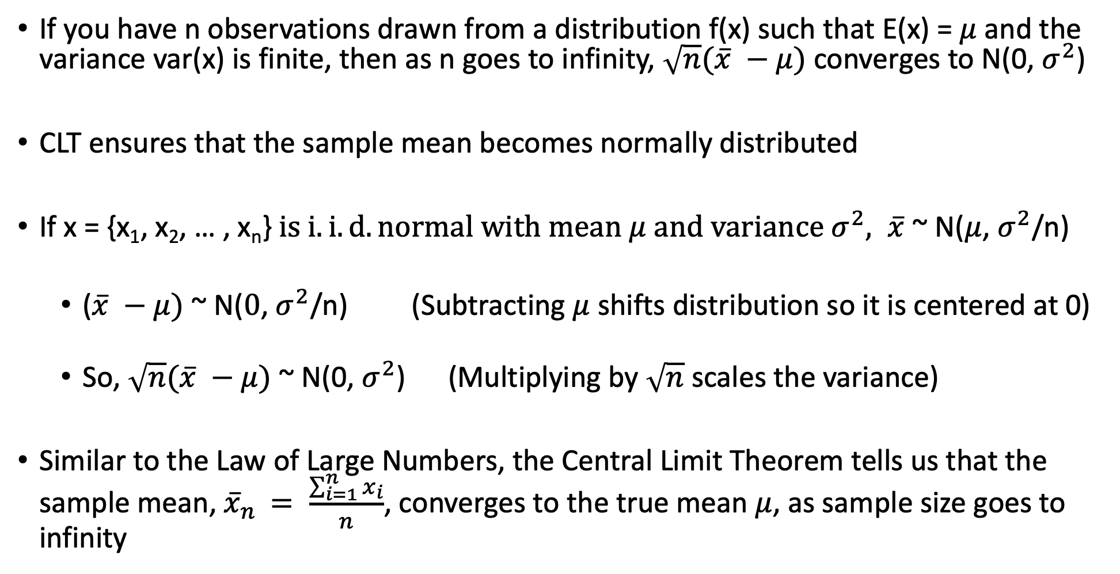
Central Limit Theorem
If you have n observations drawn from a distribution f(x) such that E(x) = $μ$ and the variance var(x) is finite, then as n goes to infinity, $\sqrt{n}(\overline{x} −μ)$ converges to N(0, $σ^{2}$)
CLT ensures that the sample mean becomes normally distributed
If x = {x₁, x₂, … , x_{n}} $is i.i.d. normal with mean μ and variance σ^{2}, \overline{x}$ ~ N($μ$, $σ^{2}$/n)
($\overline{x} −μ)$ ~ N($0$, $σ^{2}$/n) (Subtracting $μ$ shifts distribution so it is centered at 0)
So, $\sqrt{n}(\overline{x} −μ)$ ~ N(0, $σ^{2}$) (Multiplying by $\sqrt{n}$ scales the variance)
Similar to the Law of Large Numbers, the Central Limit Theorem tells us that the sample mean, ${\overline{x}}_{n }= \frac{\sum_{i=1}^{n}{x_{i}}}{n}$, converges to the true mean $μ$, as sample size goes to infinity

Slide 4
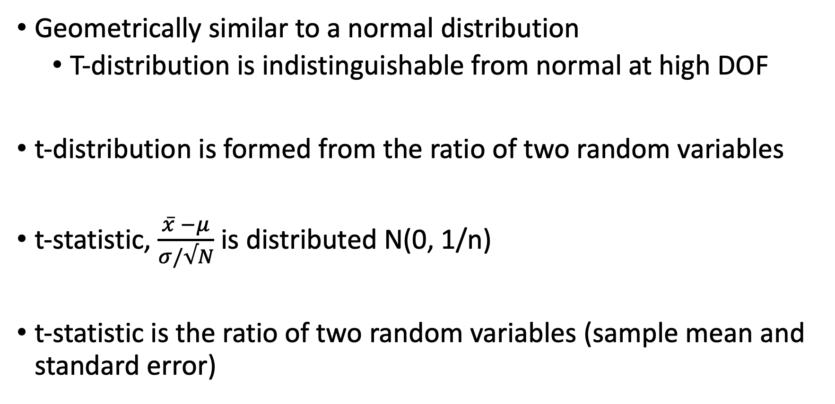
t-distributions
Geometrically similar to a normal distribution
T-distribution is indistinguishable from normal at high DOF
t-distribution is formed from the ratio of two random variables
t-statistic, $\frac{\overline{x} −μ}{σ/√N}$ is distributed N(0, 1/n)
t-statistic is the ratio of two random variables (sample mean and standard error)

Slide 5
Simulating Random Variable
To generate random variable x, have to invert the CDF
First calculate p = F(x) and then take the inverse function to get x = F⁻¹(p) = F⁻¹(u) since p is distributed U[0,1]
For example suppose we have a binary distribution where p(x=0) = 0.85 and p(x=1) = 0.15
For simulation would use uniform distribution (runif(N) in R where N is sample size) and if runif(N) < 0.85, assign a 0, else assign a 1 (alternatively, could do if runif(N) < 0.15 assign a 1, else assign a 0)
Randomly generated values will be stored in vector which will then be used to calculate sample mean

Slide 6
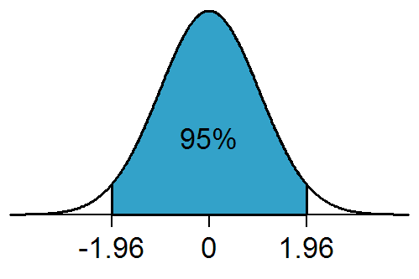
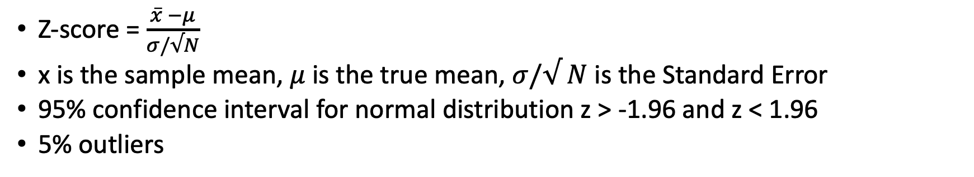


Background for HW 5
Z-score = $\frac{\overline{x} −μ}{σ/√N}$
x is the sample mean, $μ$ is the true mean, $σ/√ N$ is the Standard Error
95% confidence interval for normal distribution z > -1.96 and z < 1.96
5% outliers

Slide 7
Homework 5 Code
Monte-Carlo simulation: generates random values
For each function, you will generate 10,000 sample means, and each sample mean is calculated from a random sample of size n
You can change the sample size (n) used to calculate each of these means
For each of the 10,000 sample means, it will determine the z-score of the sample mean and whether or not it is in the 95% confidence interval
At the end, the code will return the percentage of means that are outliers (not in the 95% confidence interval)

Slide 8
Homework 5 Simulation Continued
Since this simulation is meant to model the CLT, as we increase n, we would expect the percentage of sample means that are outliers (have a z-score below -1.96 and above 1.96) to approach 5%
For example, if the sample size is 50 for each sample mean, you might get 10% outliers
But if the sample size is 500 for each sample mean, you might get 6.3% outliers
This is consistent with the CLT because the fact that approximately 5% of sample means are outliers suggests that the sample mean is normally distributed

